Slide 1
Jesus and John From Haggai and Malachi
Provide Hope …

Slide 2
Background of Haggai, Ezra, Nehemiah, Zechariah, and Malachi
Captivity
606 BC – First captives taken by Nebuchadnezzar. Daniel 1:1-2
597 BC – Second Group (10,000) taken to Babylon. 2 Kings 24:10-16; Ezekiel 1:1-3
586 BC – Jerusalem falls, temple destroyed.
2 Kings 25:1-21
539 BC – Babylon falls to Medes and Persians. Daniel 5: 25ff; Isaiah 44:27-45:1-4

Slide 3
Background of Haggai, Ezra, Nehemiah, Zechariah, and Malachi
Restoration
536 BC – Cyrus issues a decree (538) for the Jews to go back to Jerusalem; after 70 years. cf. Jer. 25:11; 29:10-14
Almost 50,000 return under the leadership of Zerubbabel (2 Chron. 36:21-23; Ezra 1)
520-516 BC – The temple is completed. Ezra 6:15;
Book of Haggai
458 BC – Ezra led a second remnant of 2,058 Jews to Jerusalem. Ezra 8:1-34; Zechariah 9-14
444 BC – Nehemiah lead a third remnant back. Nehemiah 2
445-432 BC – Malachi writes about faithfulness to the Lord.

Slide 4
Note: The culture of the day.
2nd and 3rd generation descendants had begun to lose sight of serving the Lord and wholehearted zeal. Ezra 1-4; Haggai 1:2ff
Worship was in decay, priests were careless regarding sacrifices. (Malachi 1:6-8, 13; 2:9)
Tithing had been neglected. (Malachi 3:9-10)
Indifference and skepticism characterized the nation as a whole. (Malachi 3:14; 2:17)
Divorce and intermarriage with Gentile women was common. (Malachi 2:11-16)

Slide 5
John the Baptist is Coming.
Malachi 3:1; 4:5-6
But first … Period of Silence: 400 years!
Amos 8:11-12, “Behold, the days come, saith the Lord Jehovah, that I will send a famine in the land, not a famine of bread, nor a thirst for water, but of hearing the words of Jehovah. And they shall wander from sea to sea, and from the north even to the east; they shall run to and fro to seek the word of Jehovah, and shall not find it.”

Slide 6
John the Baptist is Coming.
Malachi 3:1; 4:5-6
But first … Period of Silence: 400 years!
Note:
1 Samuel 3:1, "And the word of Jehovah was precious in those days; there was no frequent vision.”
Psalms 74:1-9 (by Asaph, believed by some to be written during the Babylonian empire), “O God, why hast thou cast (us) off for ever? Why doth thine anger smoke against the sheep of thy pasture? … We see not our signs: there is no more any prophet; neither is there among us any that knoweth how long.”

Slide 7
John the Baptist is Coming.
Malachi 3:1; 4:5-6
But first … Period of Silence: 400 years!
Note:
Lamentations 2:1-9, “How hath the Lord covered the daughter of Zion with a cloud in his anger! He hath cast down from heaven unto the earth the beauty of Israel, And hath not remembered his footstool in the day of his anger … Her gates are sunk into the ground; he hath destroyed and broken her bars: Her king and her princes are among the nations where the law is not; Yea, her prophets find no vision from Jehovah.”

Slide 8
John the Baptist is Coming.
Malachi 3:1; 4:5-6
But first … Period of Silence: 400 years!
Note:
Hosea 5:5-6, “And the pride of Israel doth testify to his face: therefore Israel and Ephraim shall stumble in their iniquity; Judah also shall stumble with them. They shall go with their flocks and with their herds to seek Jehovah; but they shall not find him: he hath withdrawn himself from them.”

Slide 9
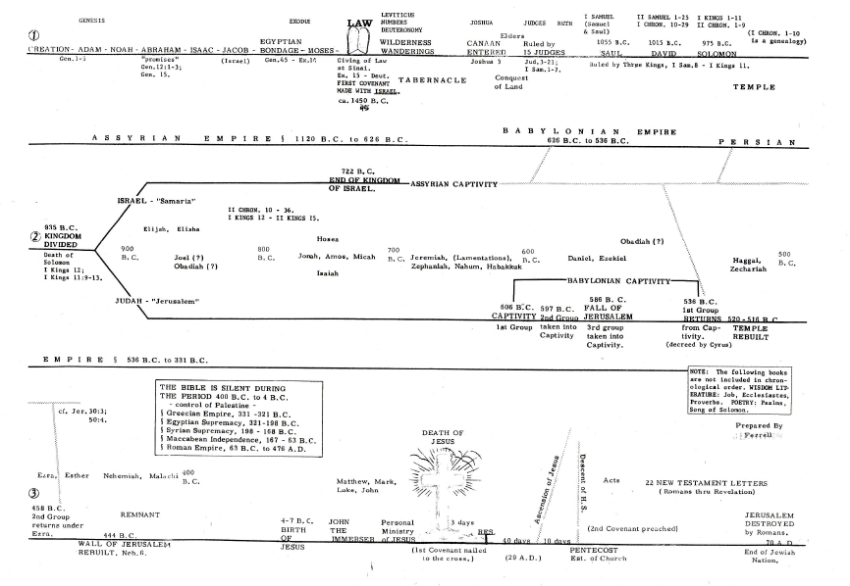
1 Samuel 3:1
Hosea 5:5-6
Lamentations 2:1-9
Haggai
Amos 1:1; 8:11-12
Malachi

Slide 10
John the Baptist is Coming.
Malachi 3:1; 4:5-6
But first … Period of Silence: 400 years!
The Bible tells us that God’s word is the spiritual food that sustains us.
Matthew 4:4, “Man shall not live by bread alone, but by every word that proceedeth out of the mouth of God”
John 6:63, “The words that I have spoken unto you are spirit, and are life”
Our spiritual life is sustained by hearing the words of Christ.
1 Peter 2:2, “as newborn babes, long for the spiritual milk which is without guile, that ye may grow thereby unto salvation”
There is a time to seek God “while he may be found” and a time to call upon him “while he is near” (Isaiah 55:6).

Slide 11
John the Baptist Came
Malachi 3:1; 4:5-6; cf. Matthew 11:14; Mark 9:11-13; Luke 1:17
Who was John? (Popular question) John 1:19-22
John was Christ's messenger. Malachi 3:1; Isaiah 40:3.
John prepared the way for Christ by preaching repentance. Luke 3:2-6.
John turned the hearts of the people back to God and His law. Malachi 4:6; Luke 1:16-17 (Matthew 17:10-13)
  John prepared hearts for the kingdom of Christ.
  Matthew 3:2, 5
  John prepared the way for Christ by preaching faith in Jesus. Acts 19:4
    As the Christ. John 1:25-27; 3:30 (Superior in rank and authority).
    As the Lamb of God. John 1:29, 34-36.

Slide 12
John the Baptist Came
Malachi 3:1; 4:5-6; cf. Matthew 11:14; Mark 9:11-13; Luke 1:17
Who was John? (Popular question) John 1:19-22
The Baptizer – Baptized Jesus. Matthew 3:13-14
John’s baptism:
  Was not a ritual of the Law of Moses
  Was commanded by this prophet of God. John 1:33
  Washed away sins when preceded by repentance. Mark 1:4
  Did not put anyone into the blood of Christ. Romans 6:3-4
  Did not make anyone a Christian, citizen in the kingdom. Matthew 11:10-11; cf. Acts 19:1-5
Why did Jesus come to be baptized by John?
  Jesus came to “do the Father's will.” cf. John 5:30; 6:38.
  Note: Luke 7:29-30 – What would or could have been said if Jesus had not accepted John's baptism? – cf. John 8:55

Slide 13
Jesus Is Coming
Haggai 2:20-23 – Message 4 – The Lord Renews The Promise Of Salvation.
Prophets declared God’s promise to overthrow the “throne of kingdoms” and the “strength of the kingdoms of nations.”
  Haggai repeats the prophecy of the shaking of the world. When this shaking takes place the throne of the kingdoms of men shall be thrown down, and the unshakeable kingdom of God shall be established (Daniel 2:44; Hebrews 12:26-28).

Slide 14
Jesus Is Coming
Haggai 2:20-23 – Message 4 – The Lord Renews The Promise Of Salvation.
The Davidic monarchy would be preserved through Zerubbabel who was a direct descendant of David through Jeconiah (cf. 1:1).
Messianic Hope Preserved In Zerubbabel. 2:23
  Make thee “as a signet,” (seal of authority).

Slide 15
Jesus Came
Haggai 2:20-23 – Message 4 – The Lord Renews The Promise Of Salvation.
God did keep His promise to Zerubbabel because he is a direct descendant of David (2 Samuel 7:11-14) and an ancestor of Jesus in the flesh (Matthew 1:12-13; Luke 3:27).
Peter declares his coronation in Acts 2.
If Jesus were to reign on earth in Judah, the prophecies of Jeremiah 22:24, 30 and Haggai 2:20-23 would become invalid. Such will not happen.

Slide 16
Application
Remember who you are.
Citizens in the kingdom of heaven.
Matthew 11:10-11, “This is he, of whom it is written, Behold, I send my messenger before thy face, Who shall prepare thy way before thee. Verily I say unto you, Among them that are born of women there hath not arisen a greater than John the Baptist: yet he that is but little in the kingdom of heaven is greater than he.”
Seek Him first. Matthew 6:19-20, 33; Luke 12:16-21; Luke 14:16-24

